Slide 1

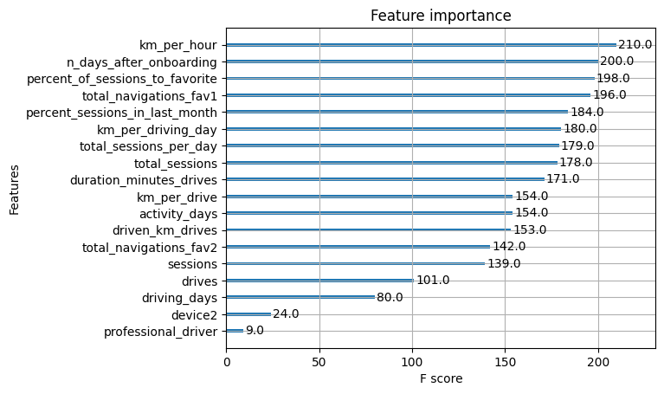
Predicts user churn project . Tree based models
Executive summary report
Waze data Team was asked to analyze and interpret data, generate valuable insights, and help leadership make informed business decisions. The project is dedicated to help prevent user churn on the Waze app. Churn quantifies the number of users who have uninstalled the Waze app or stopped using the app. At this stage of the project data Team create alternative models (tree-based models)
Waze data Team conduct EDA and features engineering. Data was used for building Random Forest model and XGBoost model, both tree-based algorithms.
Performance of both models are not sufficient with XGBoost performs slightly better.
After EDA lot of questions regarding data quality and reliability were raised. For example value equal more than 600km distance per hour, or more than 100% value for percentage features
The recall score is just 22% for the train data and 18.5% for the test data.
The accuracy less than dummy model (we have imbalanced class with 82.26% major class, so if we create dummy model, which will always predict major class, we will have accuracy 82.26%). Our model have 80.4% accuracy
The most important features are: “km per hour”, “n_days_after_onboarding”, “percent of sessions to the favorite place”
The performance of both models is inaccessible and models are not recommended for usage. Additionally the question of data quality in the dataset was raised due to lot of definitely incorrect values within the dataset. To continue it is suggested to careful investigate existing data, ask provider about its reliability and ask for additional data in order to make
performance acceptable for implementation

